Slide 1
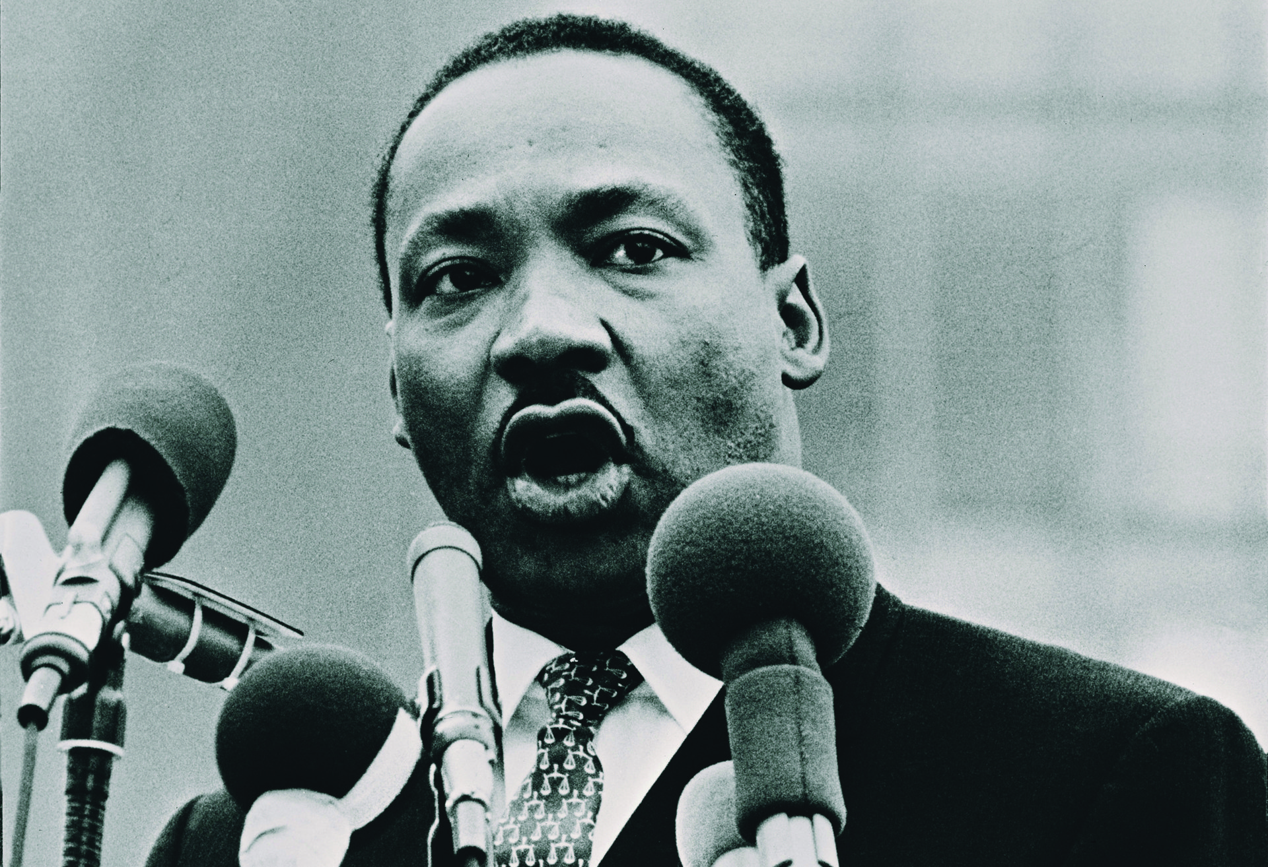
Martin Luther King

Slide 2
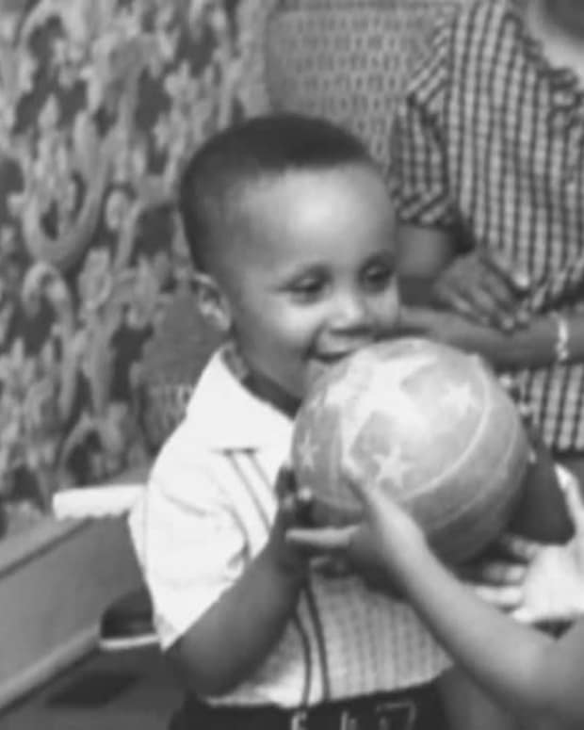
Early life
He lived in Alanta ,Georgia United States of America
He was born on January 15 1929

Slide 3
Quotes
Lighting makes no sound until it strikes
love is the only force that can make enemy into friend
https://www.youtube.com/watch?v=3vDWWy4CMhE

Slide 4
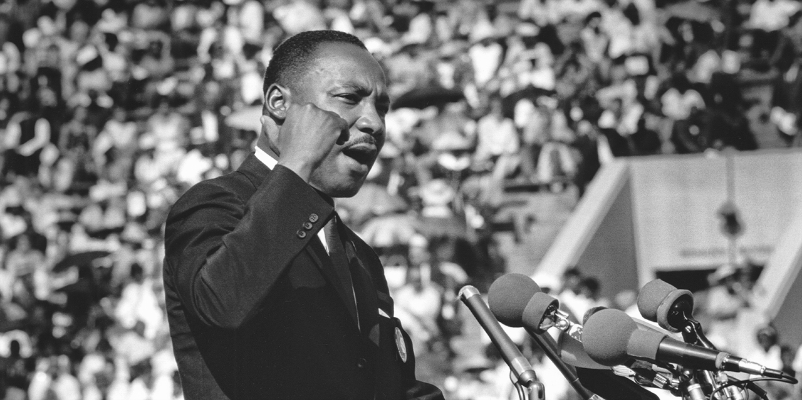
What he fought for

Slide 5
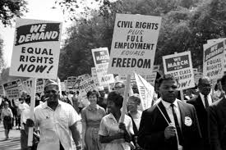
He fort for the freedom of black people in America

Slide 6
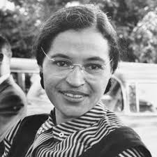
He was in a group with rosa parks and his wife

Slide 7

In the 1960 and 50’s there was injustice in America for black people and with the rule of trump there is still injustice

Slide 8
His impact
He has changed the view of people all around the world and inspired people to change there views and helped black rights movement
He has inspired many other people which led up to the first black president

Slide 9
Thank you!

